Slide 1

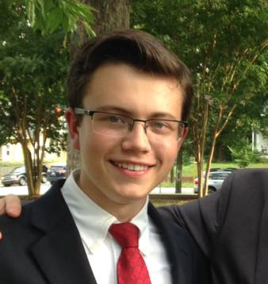




North Carolina Technology Student Association
ABOUT
JOIN
RESOURCES
DIRECTORY
EVENTS

Slide 2
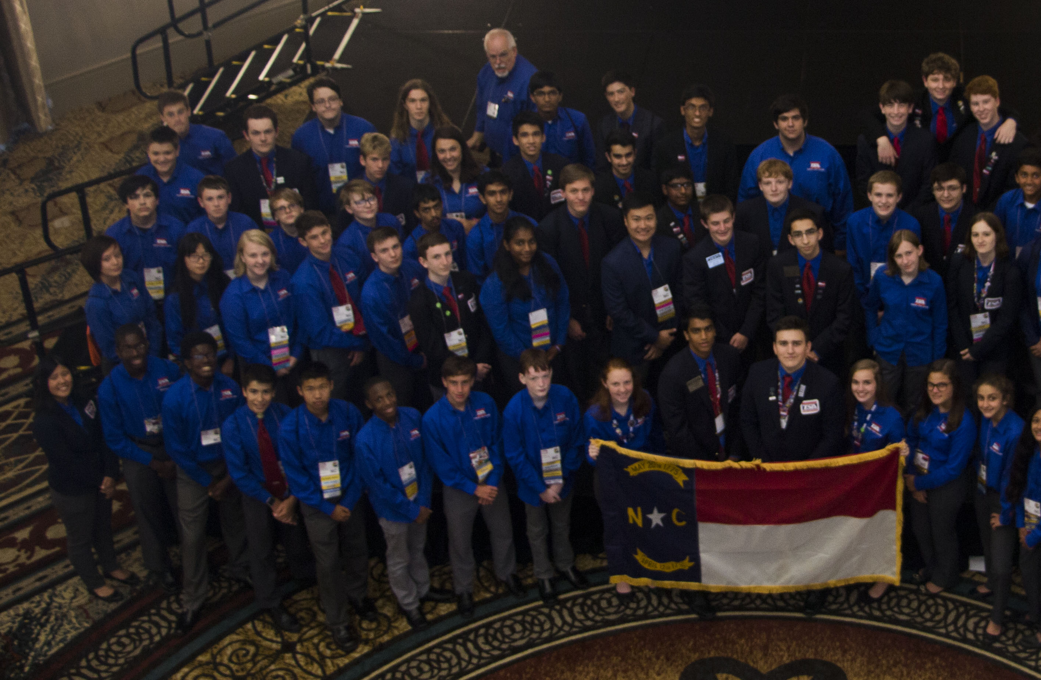
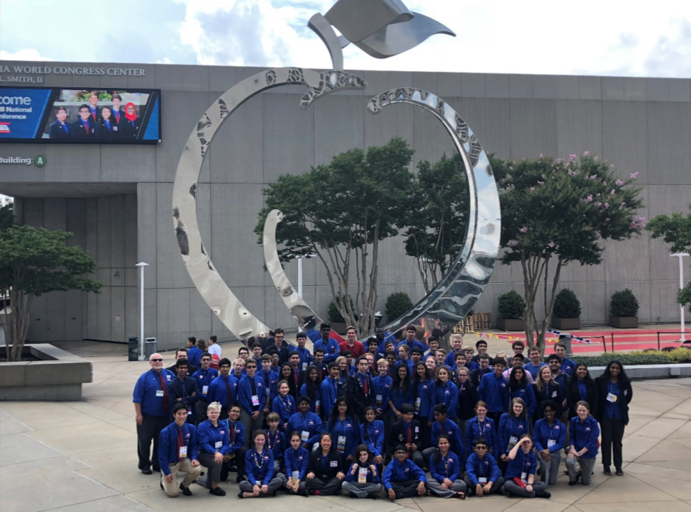

Slide 3


Slide 4


Slide 5


Slide 6


Slide 7


Slide 8


